Slide 1
CS 61C: Great Ideas in Computer Architecture (Machine Structures) Caches Part 1
Instructors:
Krste Asanović & Randy H. Katz
http://inst.eecs.berkeley.edu/~cs61c/
10/11/17
Fall 2017 - Lecture #14

Slide 2
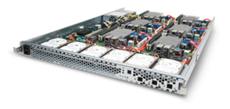
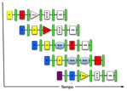
New-School Machine Structures
Software Hardware
Parallel Requests
Assigned to computer
e.g., Search “Katz”
Parallel Threads
Assigned to core
e.g., Lookup, Ads
Parallel Instructions
>1 instruction @ one time
e.g., 5 pipelined instructions
Parallel Data
>1 data item @ one time
e.g., Add of 4 pairs of words
Hardware descriptions
All gates @ one time
Programming Languages
Warehouse Scale Computer
Smart Phone
Harness Parallelism &
Achieve High Performance
Computer
Core
…
Core
Memory (Cache)
Input/Output
Core
Instruction Unit(s)
Functional
Unit(s)
A₀+B₀
A₁+B₁
A₂+B₂
A₃+B₃
Cache Memory
Logic Gates
10/11/17
Fall 2017 - Lecture #14

Slide 3
Review: Single-Cycle RISC-V RV32I Datapath
+4
Reg[]
pc
pc+4
pc
wb
1
alu
1
DataD
Reg[rs1]
ALU
2
alu
0
DMEM
0
IMEM
inst[11:7]
AddrD
Addr
1
pc+4
Branch Comp.
Reg[rs2]
DataR
wb
inst[19:15]
AddrA
DataA
0
0
DataW
mem
inst[24:20]
AddrB
DataB
1
inst[31:7]
Imm.
Gen
imm[31:0]
PCSel
inst[31:0]
ImmSel
RegWEn
BrUn
BrEq
BrLT
BSel
ASel
ALUSel
MemRW
WBSel
10/11/17
Fall 2017 - Lecture #14

Slide 4
Review: Single Cycle Instruction Timing
IF | ID | EX | MEM | WB | Total
I-MEM | Reg Read | ALU | D-MEM | Reg W
200 ps | 100 ps | 200 ps | 200 ps | 100 ps | 800 ps
10/11/17
Fall 2017 - Lecture #14

Slide 5
Review: Pipelining RISC-V RV32I Datapath
+4
Reg[]
pc
pc+4
pc
wb
1
alu
1
DataD
Reg[rs1]
ALU
2
alu
0
DMEM
0
IMEM
inst[11:7]
AddrD
Addr
1
pc+4
Branch Comp.
Reg[rs2]
DataR
wb
inst[19:15]
AddrA
DataA
0
0
DataW
mem
inst[24:20]
AddrB
DataB
1
inst[31:7]
Imm.
Gen
imm[31:0]
Instruction Fetch
(F)
Instruction Decode/Register Read
(D)
ALU Execute
(X)
Memory Access
(M)
Write Back
(W)
10/11/17
Fall 2017 - Lecture #14

Slide 6
Components of a Computer
Memory
Processor
Input
Enable?
Read/Write
Control
Program
Datapath
Address
Bytes
PC
Registers
Write Data
Data
Arithmetic & Logic Unit
(ALU)
ReadData
Output
Processor-Memory Interface
I/O-Memory Interfaces
10/11/17
Fall 2017 - Lecture #14

Slide 7
Outline
Memory Hierarchy and Latency
Caches Principles
Basic Cache Organization
Different Kinds of Caches
Write Back vs. Write Through
And in Conclusion …
10/11/17
Fall 2017 – Lecture #14

Slide 8
Outline
Memory Hierarchy and Latency
Caches Principles
Basic Cache Organization
Different Kinds of Caches
Write Back vs. Write Through
And in Conclusion …
10/11/17
Fall 2017 – Lecture #14

Slide 9
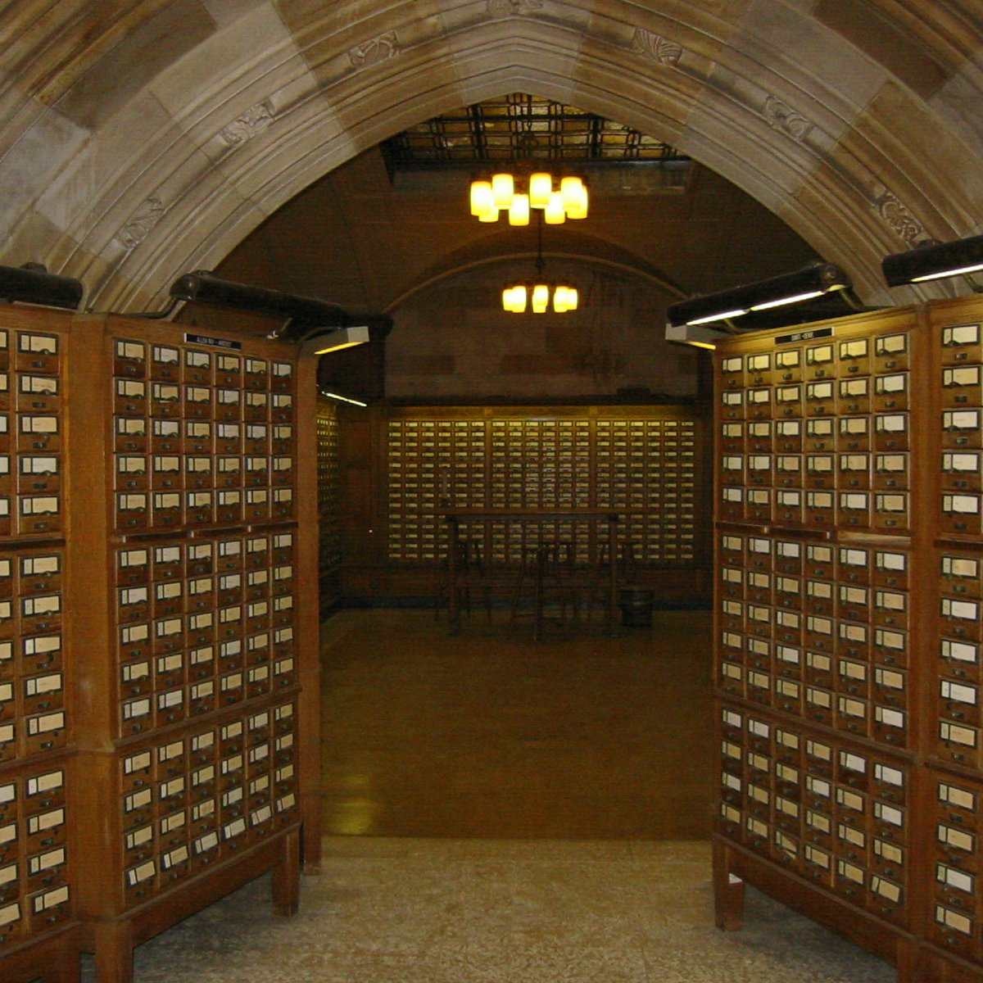
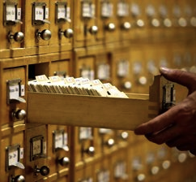
Why are Large Memories Slow? Library Analogy
Time to find a book in a large library
Search a large card catalog – (mapping title/author to index number)
Round-trip time to walk to the stacks and retrieve the desired book
Larger libraries worsen both delays
Electronic memories have same issue, plus the technologies used to store a bit slow down as density increases (e.g., SRAM vs. DRAM vs. Disk)
However what we want is a large yet fast memory!
10/11/17
Fall 2017 - Lecture #14

Slide 10
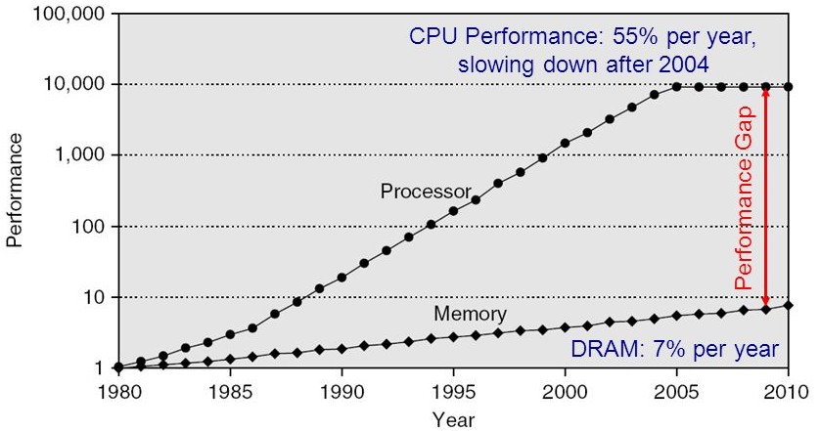
Processor-DRAM Gap (Latency)
1980 microprocessor executes ~one instruction in same time as DRAM access
2017 microprocessor executes ~1000 instructions in same time as DRAM access
Slow DRAM access has disastrous impact on CPU performance!
10/11/17
Fall 2017 - Lecture #14
Notes:
Why doesn’t DRAM get faster?

Slide 11
What To Do: Library Analogy
Write a report using library books
E.g., works of J.D. Salinger
Go to library, look up relevant books, fetch from stacks, and place on desk in library
If need more, check them out and keep on desk
But don’t return earlier books since might need them
You hope this collection of ~10 books on desk enough to write report, despite 10 being only 0.00001% of books in UC Berkeley libraries
10/11/17
Fall 2017 - Lecture #14

Slide 12
Outline
Memory Hierarchy and Latency
Caches Principles
Basic Cache Organization
Different Kinds of Caches
Write Back vs. Write Through
And in Conclusion …
10/11/17
Fall 2017 – Lecture #14

Slide 13
Big Idea: Memory Hierarchy
Processor
Inner
Increasing distance from processor, decreasing speed
Levels in memory hierarchy
Level 1
Level 2
Level 3
Outer
. . .
Level n
Size of memory at each level
As we move to outer levels the latency goes up and price per bit goes down. Why?
10/11/17
Fall 2017 - Lecture #14

Slide 14
Big Idea: Locality
Temporal Locality (locality in time)
Go back to same book on desk multiple times
If a memory location is referenced, then it will tend to be referenced again soon
Spatial Locality (locality in space)
When go to book shelf, pick up multiple books on J.D. Salinger since library stores related books together
If a memory location is referenced, the locations with nearby addresses will tend to be referenced soon
10/11/17
Fall 2017 - Lecture #14
Notes:
How does the memory hierarchy work? Well it is rather simple, at least in principle.
In order to take advantage of the temporal locality, that is the locality in time, the memory hierarchy will keep those more recently accessed data items closer to the processor because chances are (points to the principle), the processor will access them again soon.
In order to take advantage of the spatial locality, not ONLY do we move the item that has just been accessed to the upper level, but we ALSO move the data items that are adjacent to it.
+1 = 15 min. (X:55)

Slide 15
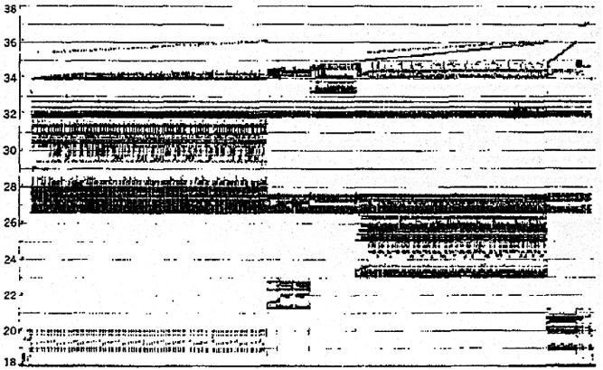
Memory Reference Patterns
Temporal
Locality
Memory Address (one dot per access)
Spatial
Locality
Donald J. Hatfield, Jeanette Gerald: Program Restructuring for Virtual Memory. IBM Systems Journal 10(3): 168-192 (1971)
Time
10/11/17
Fall 2017 - Lecture #14

Slide 16
Principle of Locality
Principle of Locality: Programs access small portion of address space at any instant of time (spatial locality) and repeatedly access that portion (temporal locality)
What program structures lead to temporal and spatial locality in instruction accesses?
In data accesses?
What structures defeat temporal and spatial locality in instruction and data accesses?
10/11/17
Fall 2017 - Lecture #14

Slide 17
Memory Reference Patterns
Address
n loop iterations
Instruction
fetches
subroutine call
subroutine return
Stack
accesses
argument access
vector access
Data
accesses
scalar accesses
Time
10/11/17
Fall 2017 - Lecture #14

Slide 18
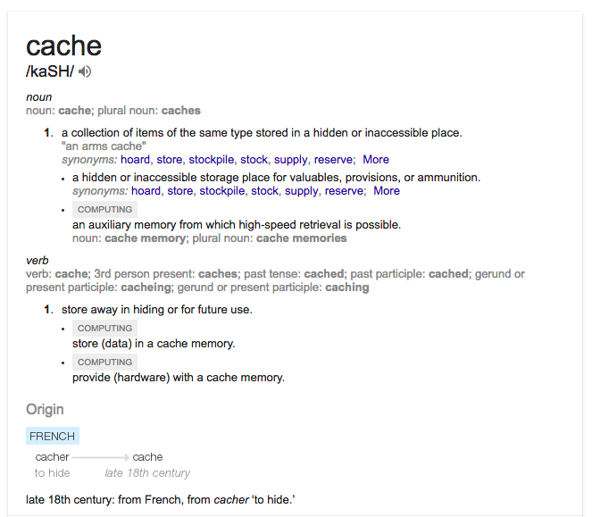
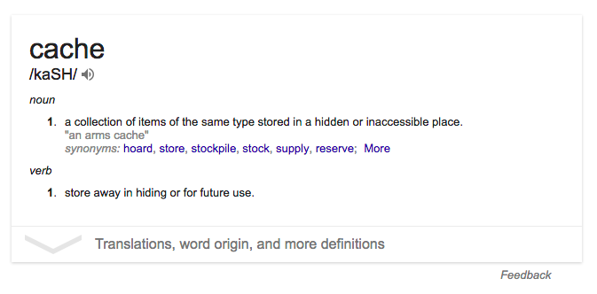
10/11/17
Fall 2017 - Lecture #14

Slide 19
Cache Philosophy
Programmer-invisible hardware mechanism gives illusion of speed of fastest memory with size of largest memory
Works even if you have no idea what a cache is
Performance-oriented programmers sometimes “reverse engineer” cache organization to design data structures and access patterns optimized for a specific cache design
You are going to do that in Project #3 (parallel programming)!
10/11/17
Fall 2017 - Lecture #14

Slide 20
Outline
Memory Hierarchy and Latency
Caches Principles
Basic Cache Organization
Different Kinds of Caches
Write Back vs. Write Through
And in Conclusion …
10/11/17
Fall 2017 – Lecture #14

Slide 21
Memory Access without Cache
Load word instruction: lw t0,0(t1)
t1 contains 1022_{ten,} Memory[1022] = 99
Processor issues address 1022_{ten} to Memory
Memory reads word at address 1022_{ten} (99)
Memory sends 99 to Processor
Processor loads 99 into register t0
10/11/17
Fall 2017 - Lecture #14

Slide 22
Adding Cache to Computer
Processor
Memory
Enable?
Read/Write
Input
Control
Program
Cache
Datapath
Memory (including
cache) organized around blocks, which are typically multiple words
Address
Bytes
PC
Write Data
Registers
Data
Arithmetic & Logic Unit
(ALU)
ReadData
Output
Processor organized around words and bytes
Processor-Memory Interface
I/O-Memory Interfaces
10/11/17
Fall 2017 - Lecture #14

Slide 23
Memory Access with Cache
Load word instruction: lw t0,0(t1)
t1 contains 1022_{ten,} Memory[1022] = 99
With cache: Processor issues address 1022_{ten} to Cache
Cache checks to see if has copy of data at address 1022_{ten}
2a. If finds a match (Hit): cache reads 99, sends to processor
2b. No match (Miss): cache sends address 1022 to Memory
Memory reads 99 at address 1022_{ten}
Memory sends 99 to Cache
Cache replaces word with new 99
Cache sends 99 to processor
Processor loads 99 into register t0
10/11/17
Fall 2017 - Lecture #14

Slide 24
Administrivia
Homework 3 has been released!
Link is on the course website
Project 1 Part 2 is due Monday
This is the same day that Project 2 Part 1 will be released!
Midterm 2 is on Oct 31 (Halloween)
10/11/17
Fall 2017 - Lecture #14

Slide 25
Break!
10/11/17
Fall 2017 - Lecture #14

Slide 26
Cache “Tags”
Need way to tell if have copy of location in memory so that can decide on hit or miss
On cache miss, put memory address of block in “tag address” of cache block
1022 placed in tag next to data from memory (99)
Tag | Data
252 | 12
1022 | 99
131 | 7
2041 | 20
From earlier
loads or stores
10/11/17
Fall 2017 - Lecture #14

Slide 27
Anatomy of a 16 Byte Cache, with 4 Byte Blocks
Processor
Operations:
Cache Hit
Cache Miss
Refill cache from memory
Cache needs Address Tags to decide if Processor Address is a Cache Hit or Cache Miss
Compares all four tags
32-bit
Address
32-bit
Data
252
12
1022
99
131
7
2041
20
Cache
32-bit
Address
32-bit
Data
Memory
10/11/17
Fall 2017 - Lecture #14

Slide 28
Cache Replacement
Suppose processor now requests location 511, which contains 11?
Doesn’t match any cache block, so must “evict” a resident block to make room
Which block to evict?
Replace “victim” with new memory block at address 511
Tag | Data
252 | 12
1022 | 99
131 | 7
2041 | 20
10/11/17
Fall 2017 - Lecture #14

Slide 29
Cache Replacement
Suppose processor now requests location 511, which contains 11?
Doesn’t match any cache block, so must “evict” a resident block to make room
Which block to evict?
Replace “victim” with new memory block at address 511
Tag | Data
252 | 12
1022 | 99
511 | 11
2041 | 20
10/11/17
Fall 2017 - Lecture #14

Slide 30
Block Must be Aligned in Memory
Word blocks are aligned, so binary address of all words in cache always ends in 00_{two}
How to take advantage of this to save hardware and energy?
Don’t need to compare last 2 bits of 32-bit byte address (comparator can be narrower)
Don’t need to store last 2 bits of 32-bit byte address in Cache Tag (Tag can be narrower)
10/11/17
Fall 2017 - Lecture #14

Slide 31
Anatomy of a 32B Cache, 8B Blocks
Processor
Blocks must be aligned in pairs, otherwise could get same word twice in cache
Tags only have even-numbered words
Last 3 bits of address always 000_{two}
Tags, comparators can be narrower
Can get hit for either word in block
32-bit
Address
32-bit
Data
252
12
-10
1022
99
1000
130
42
7
2040
1947
20
Cache
32-bit
Address
32-bit
Data
Memory
10/11/17
Fall 2017 - Lecture #14

Slide 32
Hardware Cost of Cache
Processor
Need to compare every tag to the Processor address
Comparators are expensive
Optimization: use two “sets” of data with a total of only 2 comparators
Use one Address bit to select which set
Compare only tags from selected set
Generalize to more sets
32-bit
Address
32-bit
Data
Set 0
Tag
Data
Tag
Data
Set 1
Tag
Data
Tag
Data
Cache
32-bit
Address
32-bit
Data
Memory
10/11/17
Fall 2017 - Lecture #14

Slide 33
Hardware Cost of Cache
Processor
32-bit
Address
32-bit
Data
Tag
Compare
Set 0
252
12
Even
Word
1022
99
Set 1
131
7
Odd
Word
Set Index
2041
20
Cache
31 3
2 1 0
00
32-bit
Address
32-bit
Data
Byte in word (block)
Memory
10/11/17
Fall 2017 - Lecture #14

Slide 34
Processor Address Fields Used by Cache Controller
Block Offset: Byte address within block
Set Index: Selects which set
Tag: Remaining portion of processor address
Size of Index = log₂(number of sets)
Size of Tag = Address size – Size of Index – log₂(number of bytes/block)
Processor Address (32-bits total)
Tag
Set Index
Block offset
10/11/17
Fall 2017 - Lecture #14
Notes:
For class handout

Slide 35
What Limits Number of Sets?
For a given total number of blocks, we save comparators if have more than two sets
Limit: As Many Sets as Cache Blocks => only one block per set – only needs one comparator!
Called “Direct-Mapped” Design
Tag
Index
Block offset
10/11/17
Fall 2017 - Lecture #14

Slide 36
Direct Mapped Cache Example: Mapping a 6-bit Memory Address
5
4
3
2
1
0
Tag
Index
Byte Offset
Mem Block Within $ Block
Block Within $
Byte Within Block
In example, block size is 4 bytes/1 word
Memory and cache blocks always the same size, unit of transfer between memory and cache
# Memory blocks >> # Cache blocks
16 Memory blocks = 16 words = 64 bytes => 6 bits to address all bytes
4 Cache blocks, 4 bytes (1 word) per block
4 Memory blocks map to each cache block
Memory block to cache block, aka index: middle two bits
Which memory block is in a given cache block, aka tag: top two bits
10/11/17
Fall 2017 - Lecture #14

Slide 37
One More Detail: Valid Bit
When start a new program, cache does not have valid information for this program
Need an indicator whether this tag entry is valid for this program
Add a “valid bit” to the cache tag entry
0 => cache miss, even if by chance, address = tag
1 => cache hit, if processor address = tag
10/11/17
Fall 2017 - Lecture #14

Slide 38
Break!
10/11/17
Fall 2017 - Lecture #14

Slide 39
Outline
Memory Hierarchy and Latency
Caches Principles
Basic Cache Organization
Different Kinds of Caches
Write Back vs. Write Through
And in Conclusion …
10/11/17
Fall 2017 – Lecture #14

Slide 40
Cache Organization: Simple First Example
Main Memory
0000xx
0001xx
0010xx
0011xx
0100xx
0101xx
0110xx
0111xx
1000xx
1001xx
1010xx
1011xx
1100xx
1101xx
1110xx
1111xx
One word blocks
Two low order bits (xx) define the byte in the block (32b words)
Cache
Index
Valid
Tag
Data
00
01
10
11
Q: Where in the cache is the mem block?
Use next 2 low-order memory address bits – the index – to determine which cache block (i.e., modulo the number of blocks in the cache)
Q: Is the memory block in cache?
Compare the cache tag to the high-order 2 memory address bits to tell if the memory block is in the cache (provided valid bit is set)
10/11/17
Fall 2017 - Lecture #14
Notes:
For lecture
Valid bit indicates whether an entry contains valid information – if the bit is not set, there cannot be a match for this block

Slide 41
Direct-Mapped Cache Example
One word blocks, cache size = 1K words (or 4KB)
Byte offset
31 30 . . . 13 12 11 . . . 2 1 0
Hit
Tag
20
10
Data
Valid bit ensures something useful in cache for this index
Index
Read data from cache instead of memory if a Hit
Index
Valid
Tag
Data
0
1
2
.
.
.
1021
1022
1023
Compare Tag with upper part of Address to see if a Hit
20
32
Comparator
What kind of locality are we taking advantage of?
10/11/17
Fall 2017 - Lecture #14
Notes:
Let’s use a specific example with realistic numbers: assume we have a 1 K word (4Kbyte) direct mapped cache with block size equals to 4 bytes (1 word).
In other words, each block associated with the cache tag will have 4 bytes in it (Row 1).
With Block Size equals to 4 bytes, the 2 least significant bits of the address will be used as byte select within the cache block.
Since the cache size is 1K word, the upper 32 minus 10+2 bits, or 20 bits of the address will be stored as cache tag.
The rest of the (10) address bits in the middle, that is bit 2 through 11, will be used as Cache Index to select the proper cache entry
Temporal!

Slide 42
Multiword-Block Direct-Mapped Cache
Four words/block, cache size = 1K words
Byte offset
Hit
31 30 . . . 13 12 11 . . . 4 3 2 1 0
Data
Tag
20
8
2
Word offset
Index
Index
Valid
Tag
Data
0
1
2
.
.
.
253
254
255
20
32
What kind of locality are we taking advantage of?
10/11/17
Fall 2017 - Lecture #14
Notes:
to take advantage for spatial locality want a cache block that is larger than word word in size.

Slide 43
Alternative Cache Organizations
“Fully Associative”: Block can go anywhere
First design in lecture
Note: No Index field, but one comparator/block
“Direct Mapped”: Block goes one place
Note: Only 1 comparator
Number of sets = number blocks
“N-way Set Associative”: N places for a block
Number of sets = number of blocks / N
N comparators
Fully Associative: N = number of blocks
Direct Mapped: N = 1
10/11/17
Fall 2017 - Lecture #14

Slide 44
Range of Set-Associative Caches
For a fixed-size cache, and a given block size, each increase by a factor of two in associativity doubles the number of blocks per set (i.e., the number of “ways”) and halves the number of sets –
Decreases the size of the index by 1 bit and increases the size of the tag by 1 bit
More Associativity (more ways)
Tag
Index
Block offset
What if we can also change the block size?
10/11/17
Fall 2017 - Lecture #14
Notes:
For class handout

Slide 45
Example: Alternatives in an 8 Block Cache
Direct Mapped: 8 blocks, 1 way, 1 tag comparator, 8 sets
Fully Associative: 8 blocks, 8 ways, 8 tag comparators, 1 set
2 Way Set Associative: 8 blocks, 2 ways, 2 tag comparators, 4 sets
4 Way Set Associative: 8 blocks, 4 ways, 4 tag comparators, 2 sets
DM: 8 sets
1 way
0
FA: 1 set
8 ways
0
2 Way SA: 4 sets
0
4 Way SA: 2 sets
0
Set 0
1
1
1
1
Set 0
2
2
2
2
Set 1
3
3
3
3
4
4
4
4
Set 2
5
5
5
5
Set 1
6
6
6
6
Set 3
7
7
7
7
10/11/17
Fall 2017 - Lecture #14
45

Slide 46
Peer Instruction
For a cache with constant total capacity, if we increase the number of ways by a factor of two, which statement is false:
A : The number of sets could be doubled
B : The tag width could decrease
C : The block size could stay the same
D : The block size could be halved
10/11/17
Fall 2017 - Lecture #14

Slide 47
Total Cache Capacity =
Associativity * # of sets * block_size
Bytes = blocks/set * sets * Bytes/block
C = N * S * B
Tag
Index
Byte Offset
address_size = tag_size + index_size + offset_size
= tag_size + log₂(S) + log₂(B)
Double the Associativity: Number of sets?
tag_size? index_size? # comparators?
Double the Sets: Associativity?
tag_size? index_size? # comparators?
10/11/17
Fall 2017 - Lecture #14

Slide 48
Chip Photos
10/11/17
Fall 2017 - Lecture #14

Slide 49
Outline
Memory Hierarchy and Latency
Caches Principles
Basic Cache Organization
Different Kinds of Caches
Write Back vs. Write Through
And in Conclusion …
10/11/17
Fall 2017 – Lecture #14

Slide 50
And In Conclusion, …
Principle of Locality for Libraries /Computer Memory
Hierarchy of Memories (speed/size/cost per bit) to Exploit Locality
Cache – copy of data lower level in memory hierarchy
Direct Mapped to find block in cache using Tag field and Valid bit for Hit
10/11/17
Fall 2017 - Lecture #14

